Slide 1
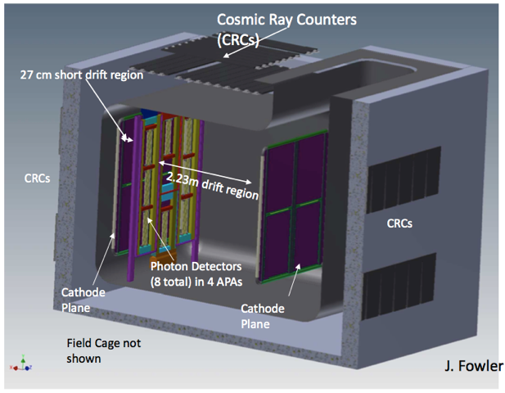
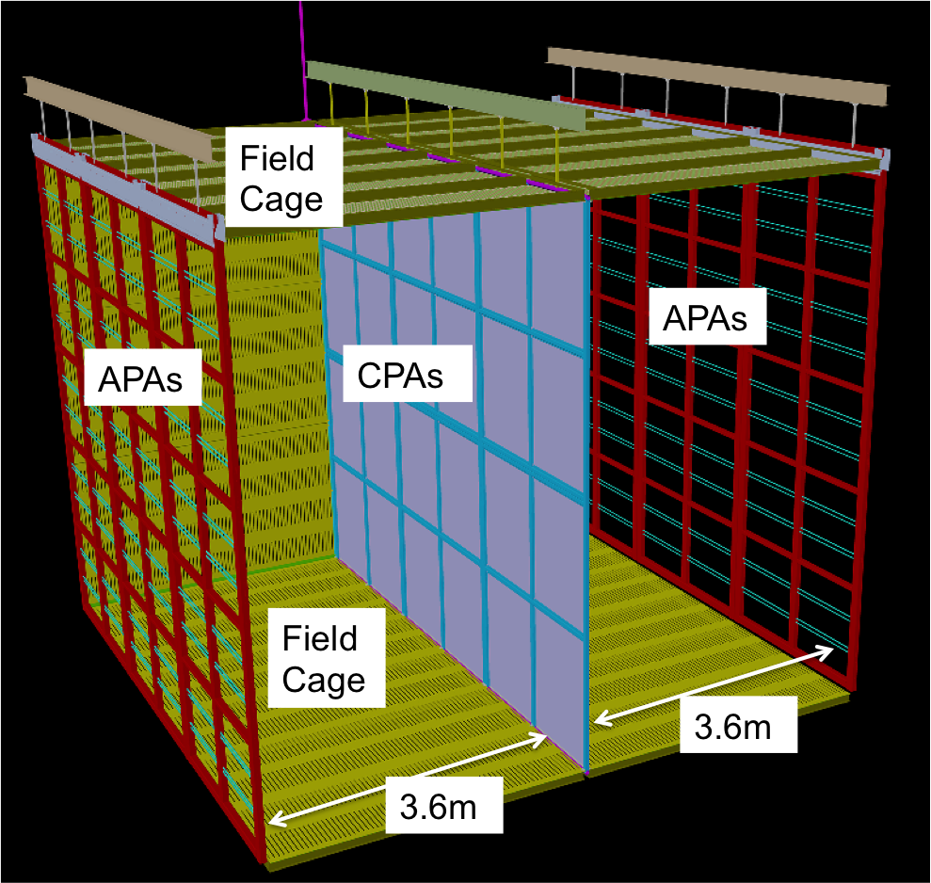
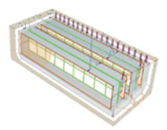
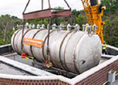
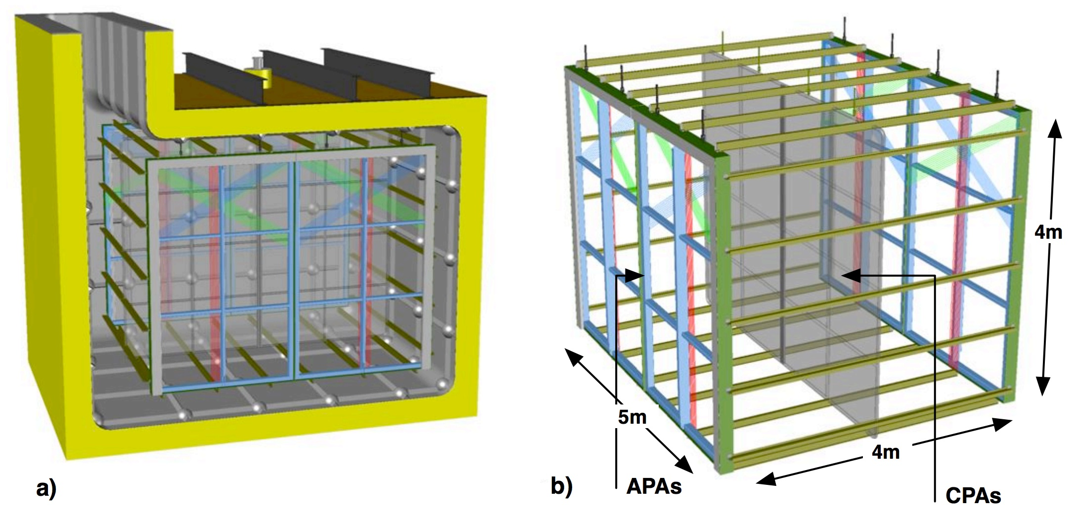
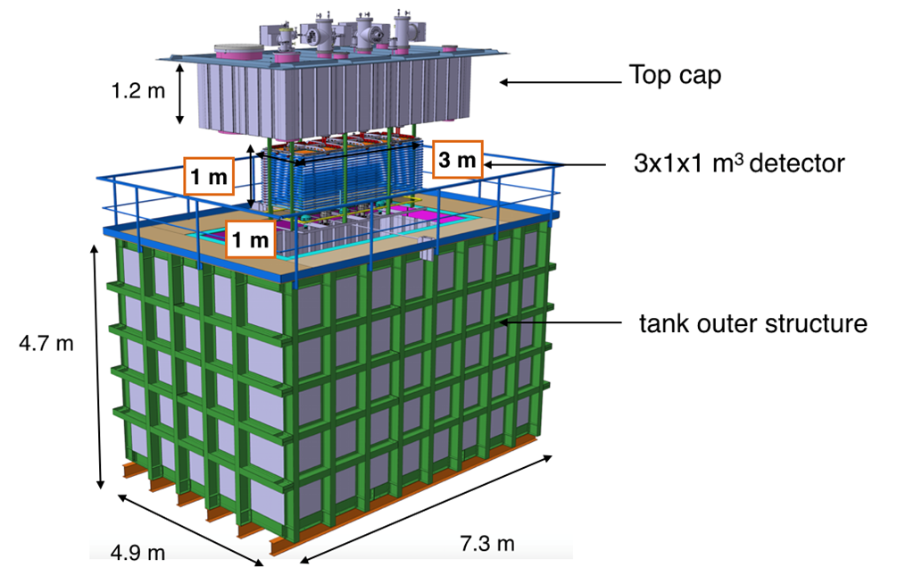
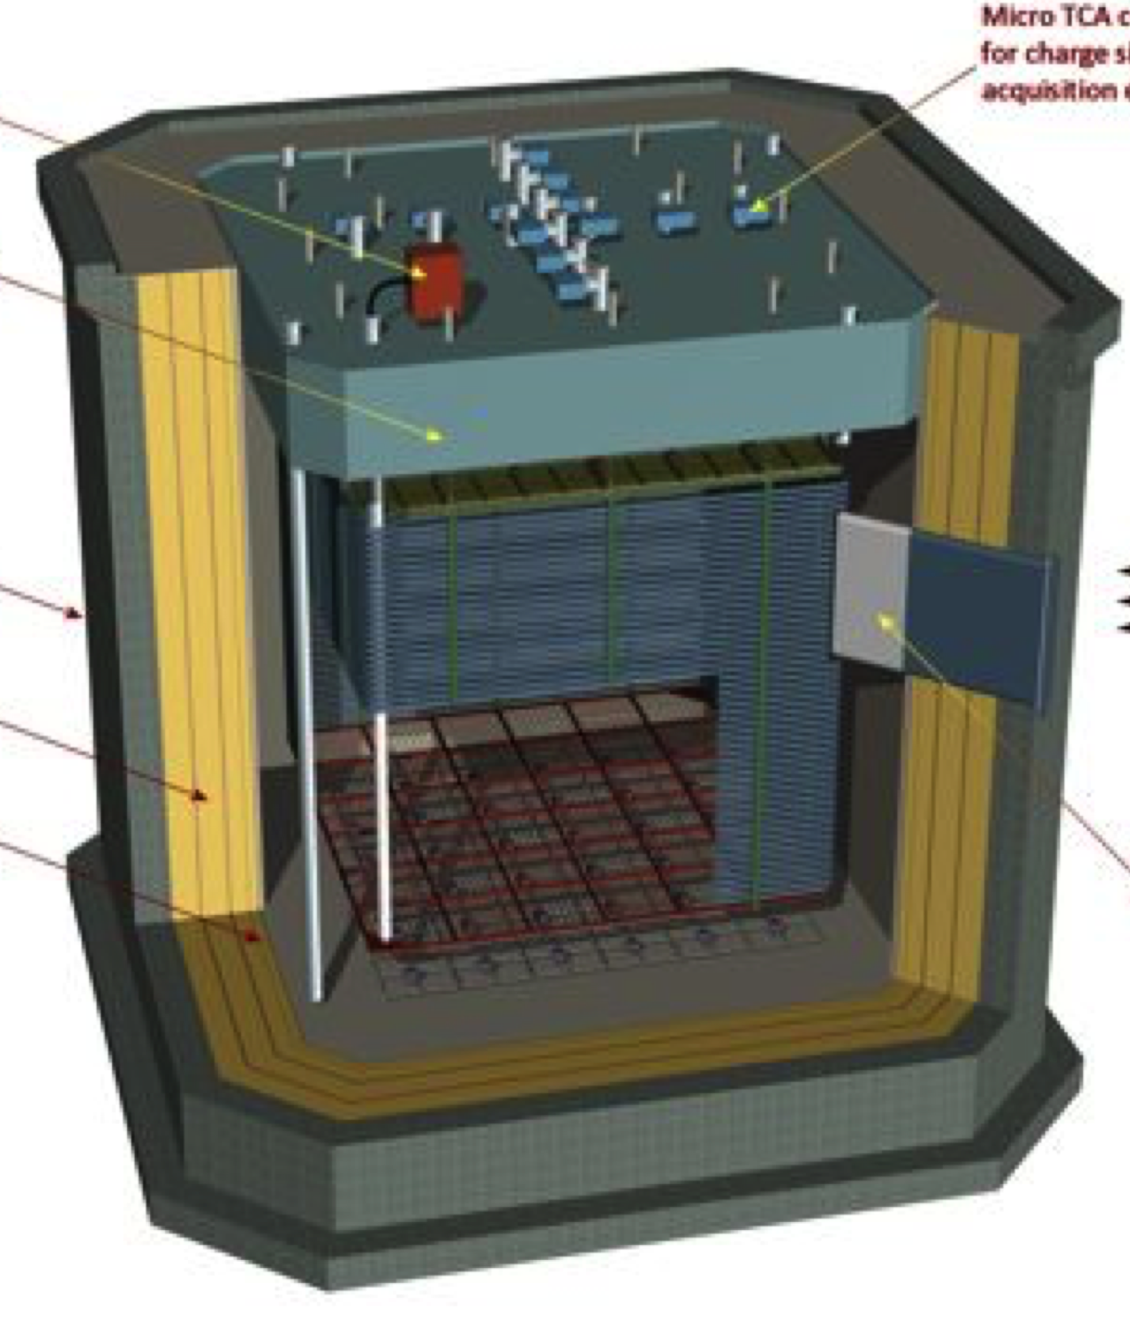
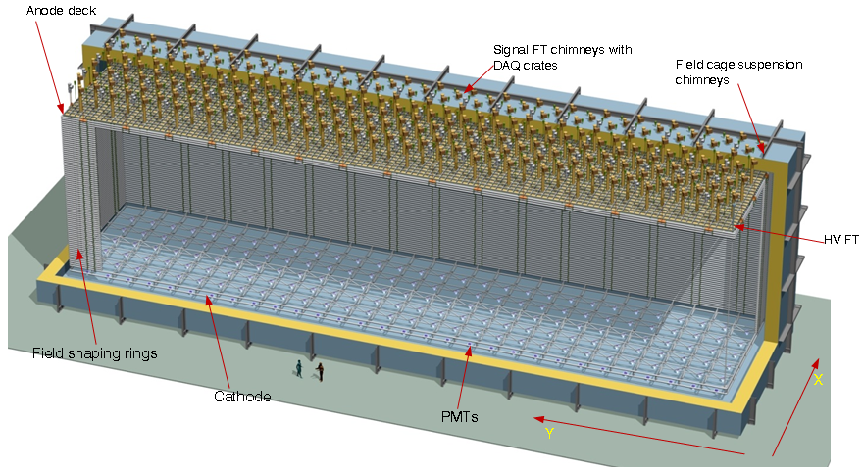
Single Phase detectors
35 ton @ FNAL
ProtoDUNE @ CERN
ICARUS
SP reference design @ SURF
MicroBooNE@ FNAL
SBND@ FNAL
Dual Phase detectors
WA105 @ CERN
WA105 @ CERN
DP alternative design @ SURF

